Slide 1

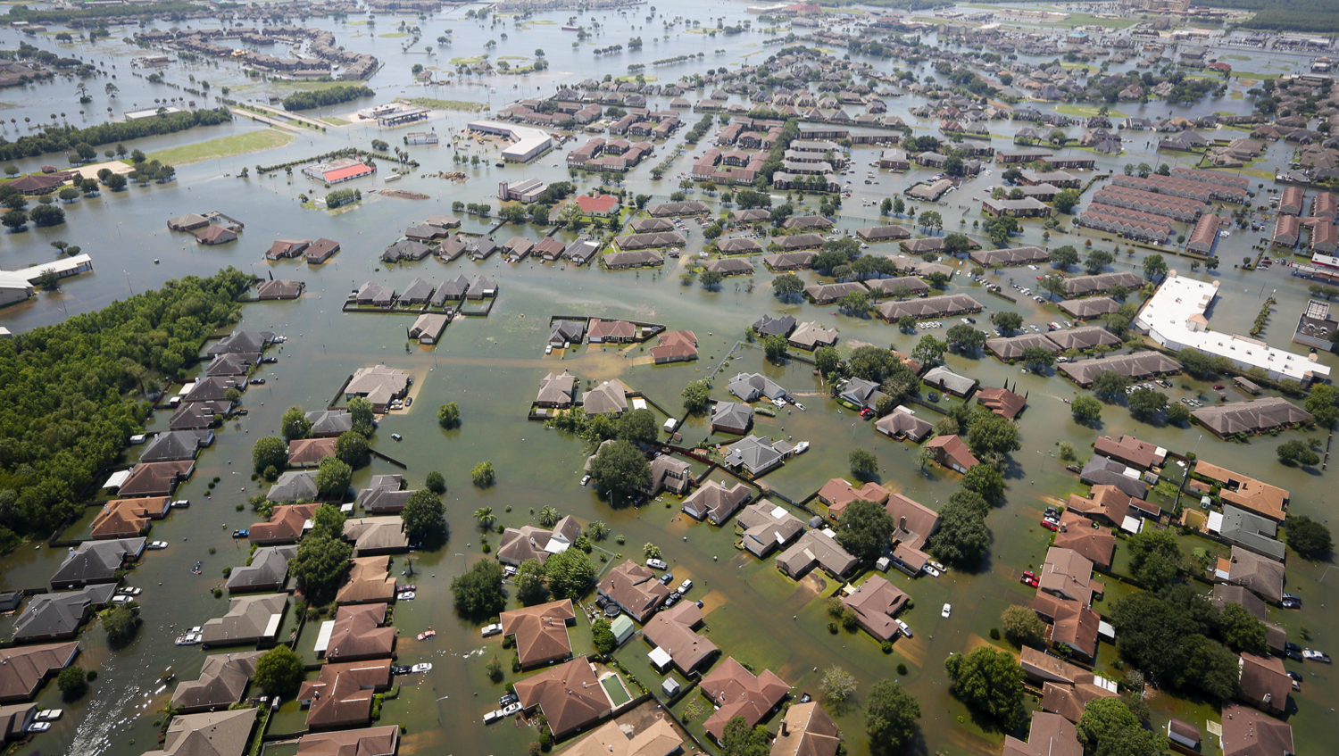
DSI Project 5: NLT Project
Post-Disaster Damage Assessment Tools
Sade Ekulona, Nick Minaie, Jeremy Opacich, Andrew Picart
DSI-8, August 2019

Slide 2
Problem Statement
Develop a web-based tool to:
Retrieve pre-disaster screenshots of the damaged structures from Google Street View
Design a damage assessment form to help and guide the assessment efforts
Other features “suggested” by the client that we incorporated:
Prioritize damage assessment efforts
Suggest the closest route between damaged locations and propose the sequence of visits
Notes:
Challenge: During the recovery phase immediately following a disaster, FEMA performs damage assessment “on the ground” to assess the level of damage.

Slide 3






Project Flow
Natural Disaster
Damaged Properties
Application for Fed Assistance
This Project
Assessment Prioritization
DAPRI
Visit Route Opt.
SIVIRO
Field Assessment
Web-PDA

Slide 4
DAPRI
Damage
Assessment
Prioritization
Tool

Slide 5
DAPRI
Considerations
Ethical
Socially and economically unbiased
Livability, severity of damage, access to utilities, and other factors
Practical
Logistics
Agency’s policies, practices, and considerations

Slide 6
DAPRI
Priority Index (PI) takes into account:
- Damage Level
- Home Safe To Live
- Level of Access to Utilities
- Level of Insurance Coverage
- (Application Estimate) / (Home Value)

Slide 7
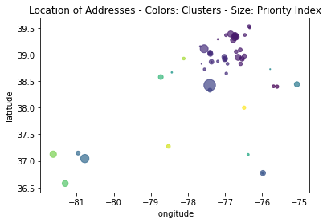
DAPRI
Steps for Prioritization:
Calculate a Priority Index (PI) for each property
Cluster properties based on their lat/long
Calculate average PI for each cluster
Sort clusters based on their average PI
Sort properties in each cluster based on their individual PIs
Property Clusters

Slide 8

DAPRI
Interactive Maps – Color Coded Based on Damage Level
See “demo” folder for videos.

Slide 9
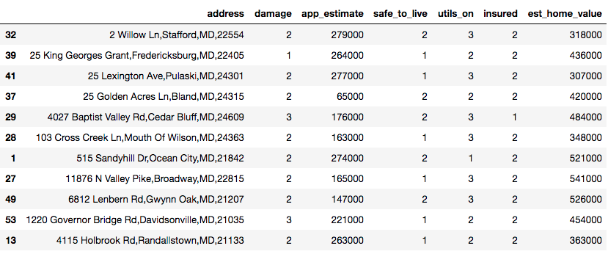
DAPRI
Prioritized List of Properties to Inform Assessment Efforts (input to SIVIRO)
Prioritized Order

Slide 10
HTML-Based Interactive Maps
Google maps:
HTML-based
Interactive
Customizable for showing information
Ability to add layers, e.g. Heatmaps

Slide 11
Demo of the Maps
See “demo” folder for videos.

Slide 12
SIVIRO
Site Visit
Route Optimizer

Slide 13
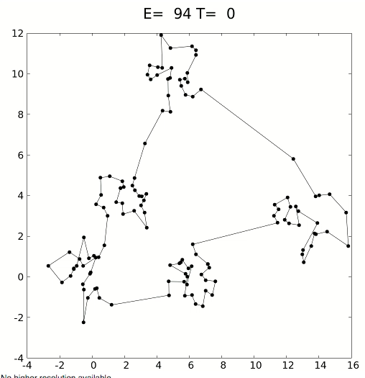
SIVIRO Solution #1
Traveling Salesman Problem
Genetic algorithm, brute-force, and unsupervised clustering
9,580,000,000 route combinations:
12 destinations
20 different parameters.
Animation from Wikimedia Commons

Slide 14
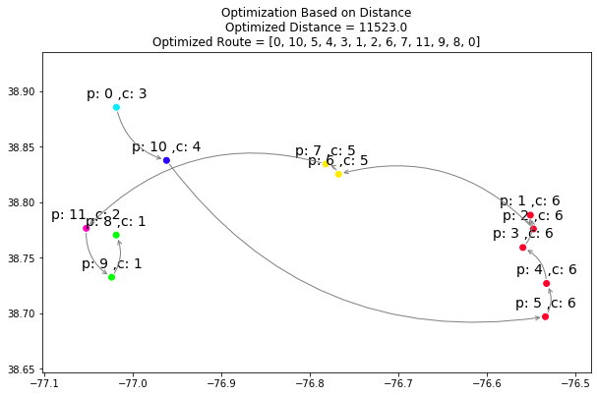
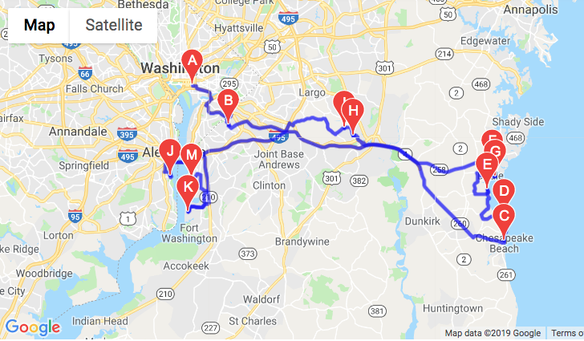
SIVIRO Solution #1

Slide 15
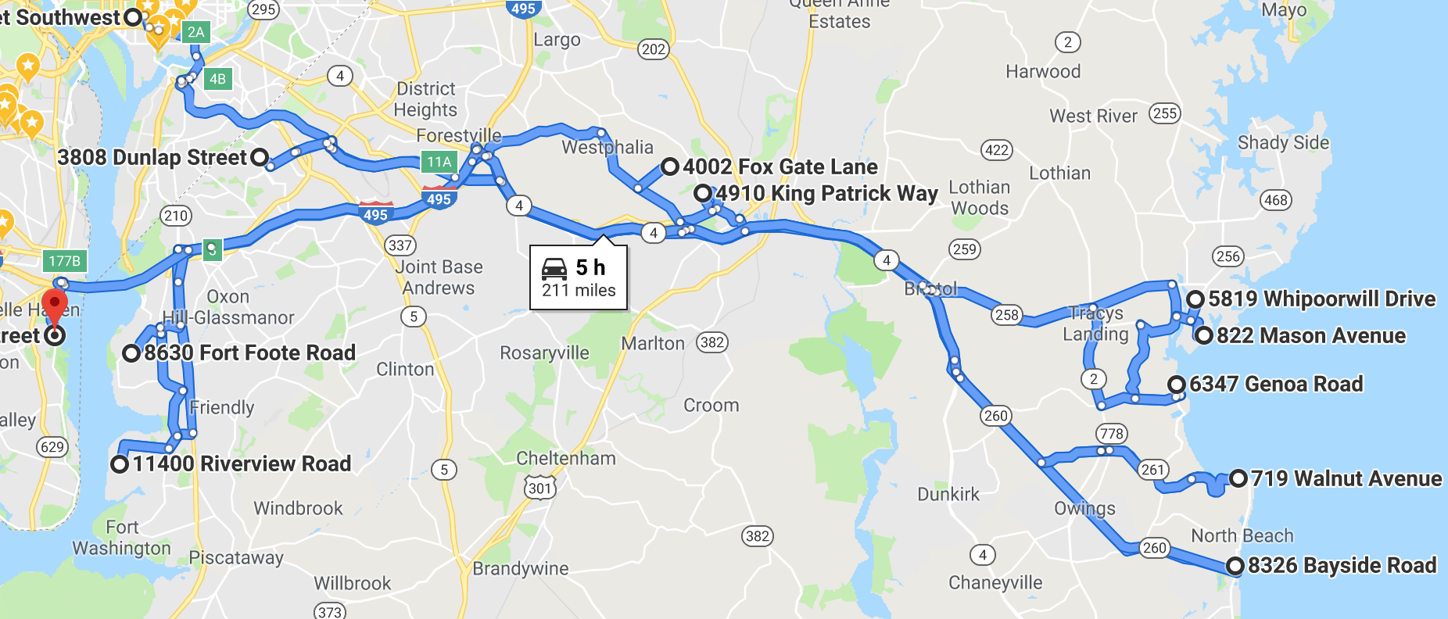
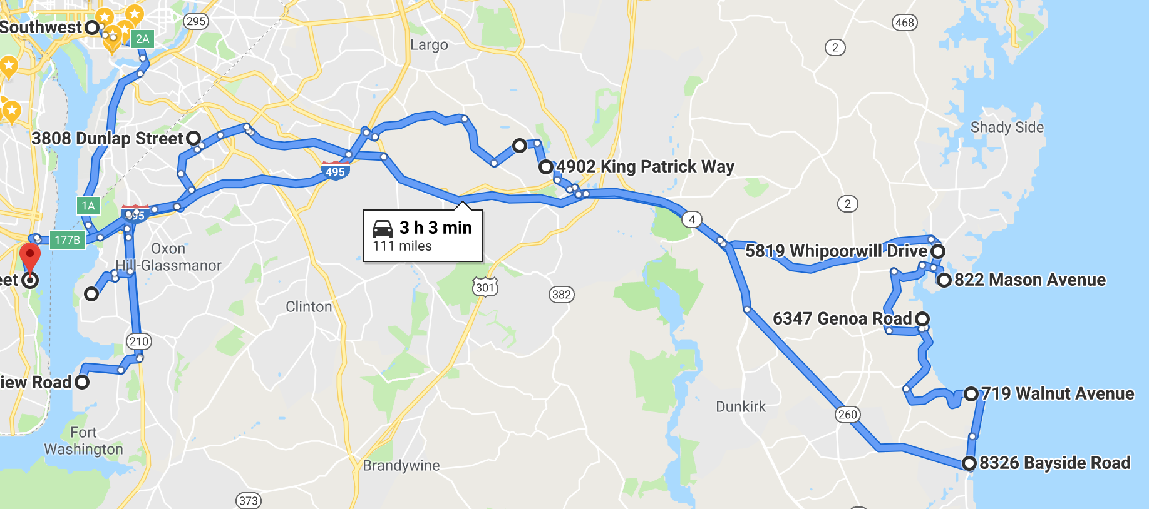
SIVIRO Solution #2
Google APIs (Production model)
Non-Optimized Route 5 hrs (12 points)
Optimized Route 3 hrs – 3 mins (12 points)

Slide 16
Web PDA
Web-Based
Preliminary Damage
Assessment

Slide 17
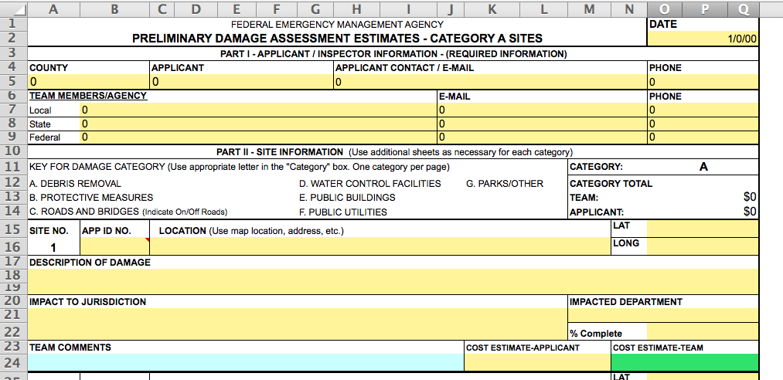
Current Damage Assessment Form
Yellow fields are
submitted with the application
FEMA Team adds comments based on site visit
FEMA’s Cost Estimate based on site visit

Slide 18
Web PDA
Considerations:
Retain information from the current Excel forms
Retrieve pre-disaster picture from Google Street View
Improvements:
Expand property attributes data
Obtain additional damage information
Modernized information management system
Cross tool/platform integration

Slide 19
Web-PDA
Features:
Secured login
Web-based integration:
Zillow API
Multiple Google Maps APIs
Store the data in an online database
Comprehensive property information:
Zillow estimates
Google street image
Location
Application details
Agent’s assessment

Slide 20
Demo of the Web-PDA
See “demo” folder for videos.

Slide 21
Future Improvements
Web-based tool for application submission
Revise DAPRI’s algorithm based on the client’s needs and comments
Use DAPRI’s outcomes to inform other agency activities
Import road closure information into DAPRI and SIVIRO
Integrate all tools into Web-PDA
Extend the platform to a phone app
Extract damage levels from satellite imagery

